Slide 1
Experiments - NIM-PET

Slide 2
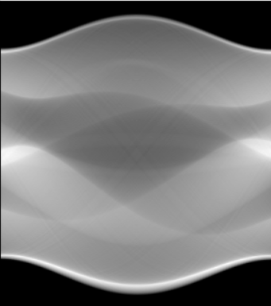
Experiment 2 - Sinogram Reconstruction
Y
SIREN
X
Model input
Model output
Loss = MSE( Model output, Shepp-Logan Sinogram)

Slide 3
Results
Optimizer | Angles | LR | Steps | Omega_0 | MSE | PSNR
Adam | 180 | 1e-4 | 4000 | 30 | 1493.2 | 14.76
Adam | 180 | 1e-4 | 8000 | 30 | 108.96 | 26.13
Adam | 180 | 1e-4 | 10000 | 30 | 41.90 | 30.28
Adam | 180 | 1e-4 | 10000 | False | 42.35 | 30.24
Adam | 180 | 1e-4 | 15000 | 30 | 1.52

Slide 4
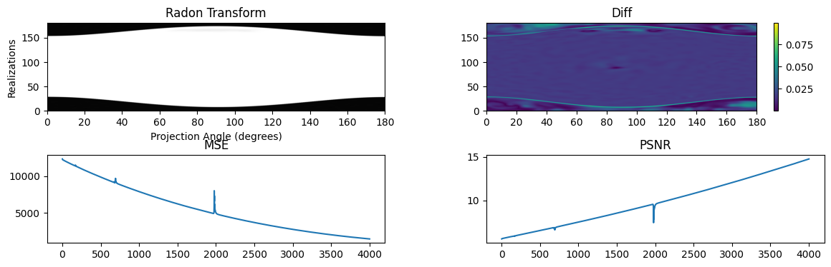
Adam : LR=1e-4 (4000 steps)

Slide 5
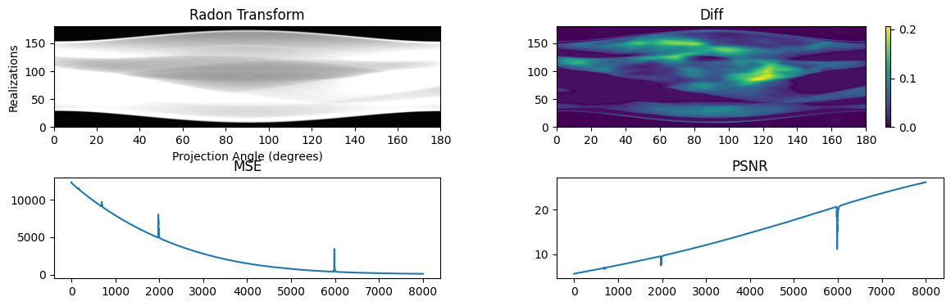
Adam : LR=1e-4 (8000 steps)

Slide 6
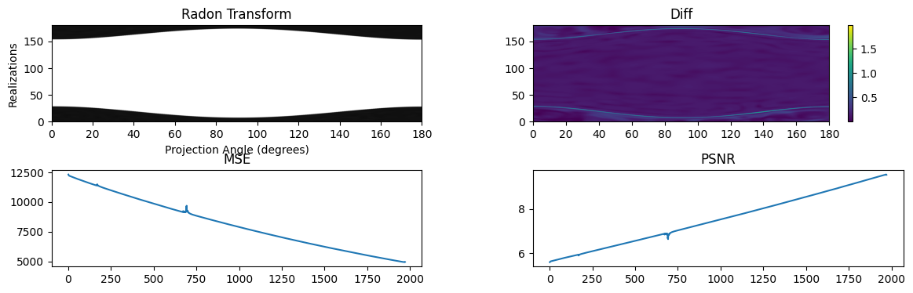
Adam : LR=1e-4 (8000 steps) - Analyzing before decrease

Slide 7
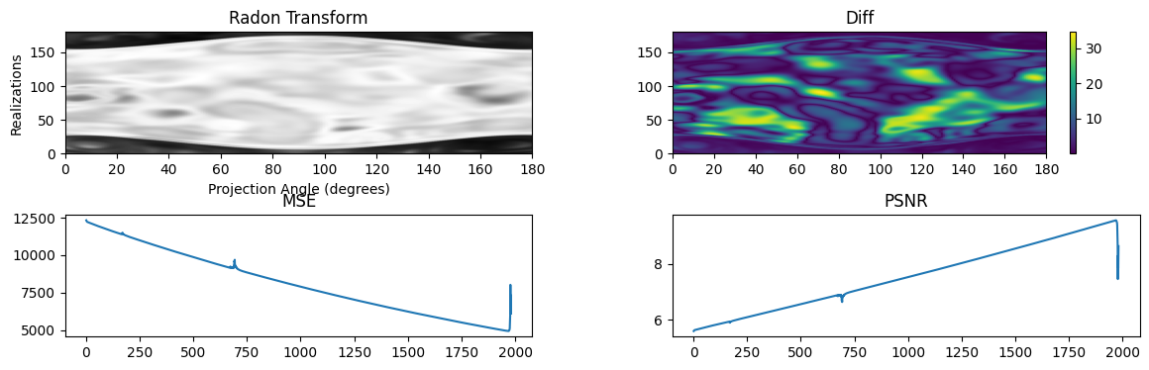
Adam : LR=1e-4 (8000 steps) - Analyzing After decrease

Slide 8
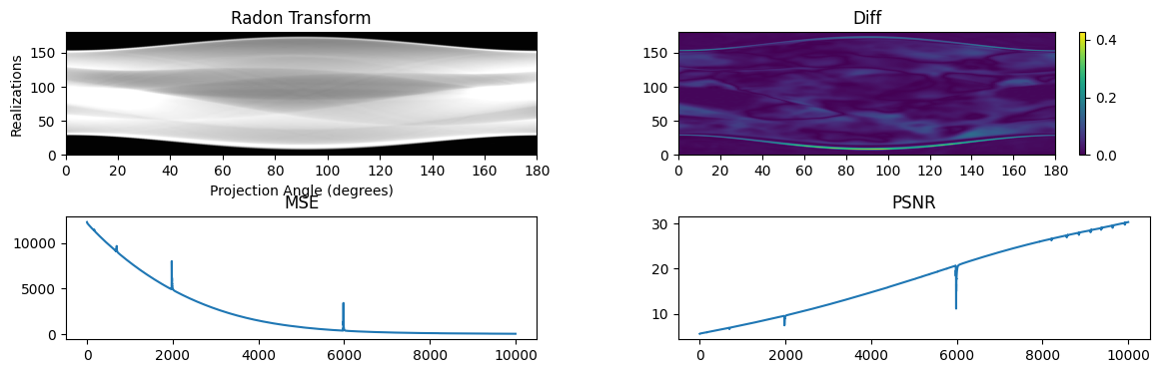
Adam : LR=1e-4 (10000 steps) - 180 Angles

Slide 9
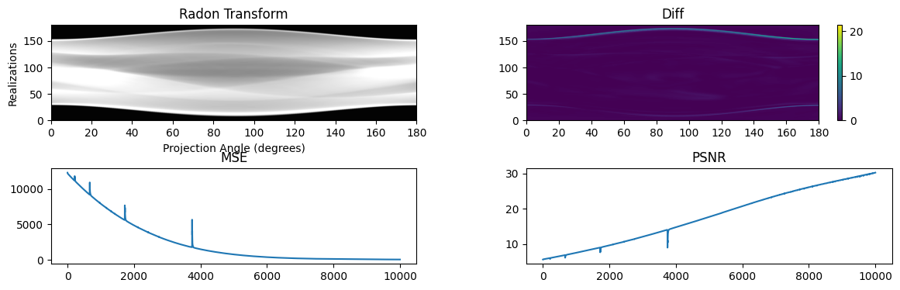
Adam : LR=1e-4 (10000 steps) - 180 Angles - Omega_0 False

Slide 10
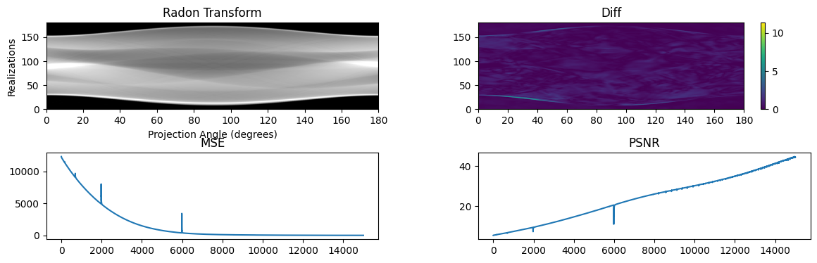
Adam : LR=1e-4 (15000 steps) - 180 Angles

Slide 11
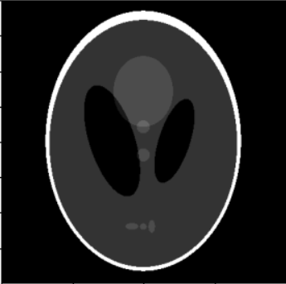
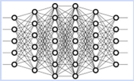
Experiment 3 - Image Denoising
Y
SIREN
X
Model output
Radon transform
Model input
Loss = MSE( Sinogram, Shepp-Logan Sinogram)
Sinogram

Slide 12
Results
Optimizer | Angles | LR | Steps | Omega_0 | MSE | PSNR
Adam | 180 | 1e-4 | 2000 | 30 | 0.69 | 42.21
Adam | 180 | 1e-3 | 2000 | 30 | 0.21 | 47.49
Adam | 80 | 1e-4 | 2000 | 30 | 0.68 | 42.49
Adam | 50 | 1e-4 | 2000 | 30 | 0.65 | 42.55
Adam | 50 | 1e-4 | 2000 | False | 1.97 | 37.65
Adam | 30 | 1e-4 | 2000 | 30 | 0.65 | 42.43

Slide 13
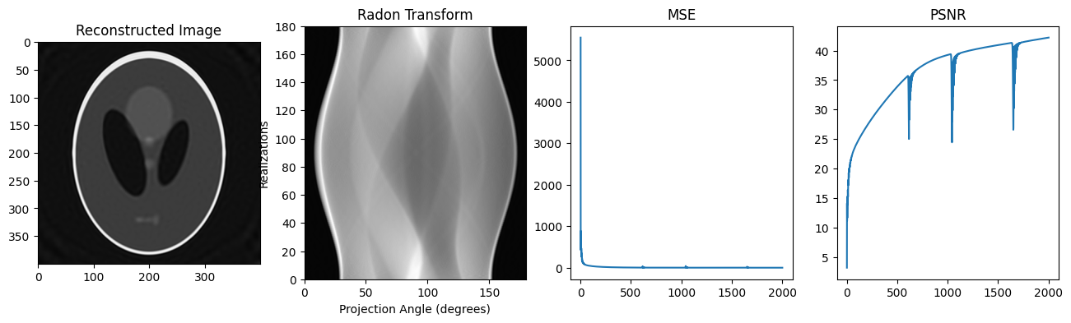
Adam : LR=1e-4 - Angles 180 (2000 steps)

Slide 14
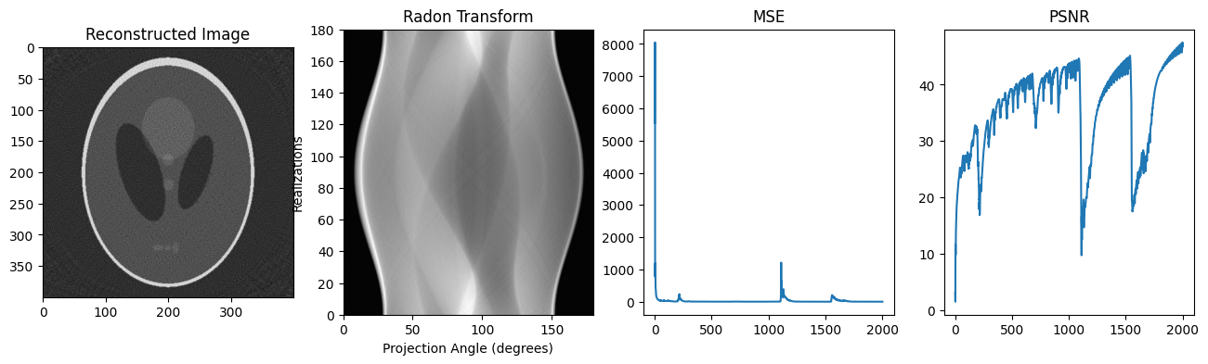
Adam : LR=1e-3 - Angles 180 (2000 steps)

Slide 15
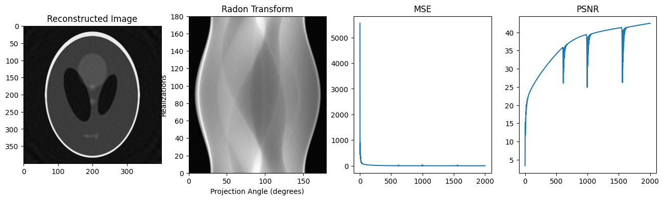
Adam : LR=1e-4 - Angles 80 (2000 steps)

Slide 16

Adam : LR=1e-4 - Angles 50 (2000 steps)

Slide 17
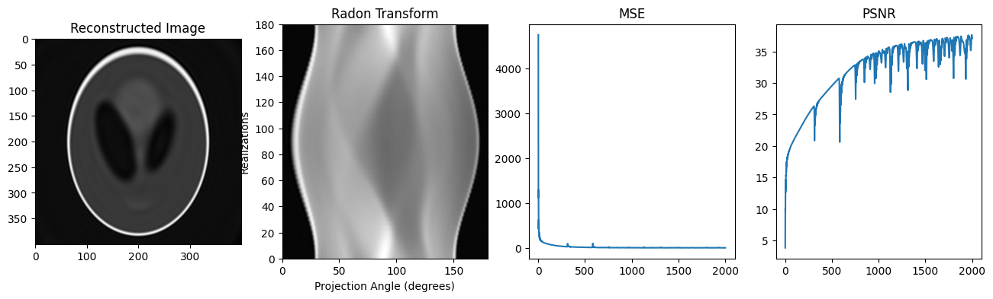
Adam : LR=1e-4 - Angles 50 - Omega_0 =False (2000 steps)

Slide 18
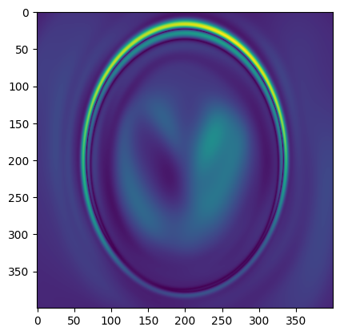
When PSNR decays :

Slide 19

Adam : LR=1e-4 - Angles 30 (2000 steps)

Slide 20
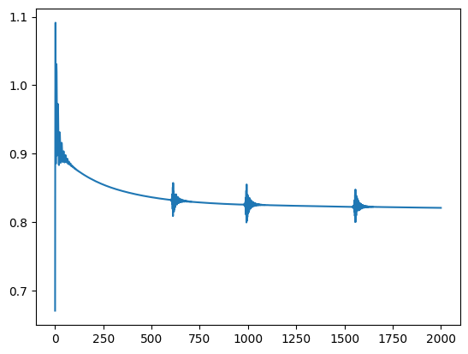
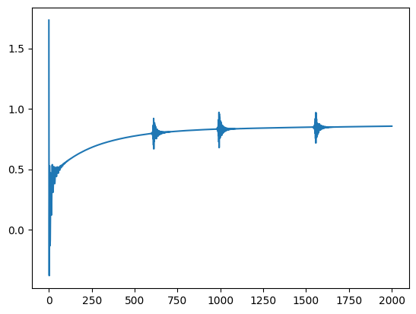
MSE and PSNR of the images in the Image Denoising
MSE of the Image
PSNR of the Image

